Slide 1
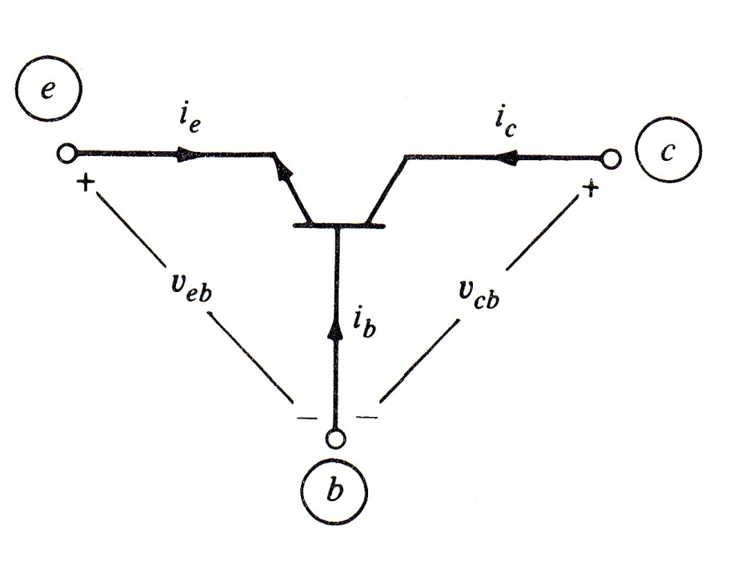
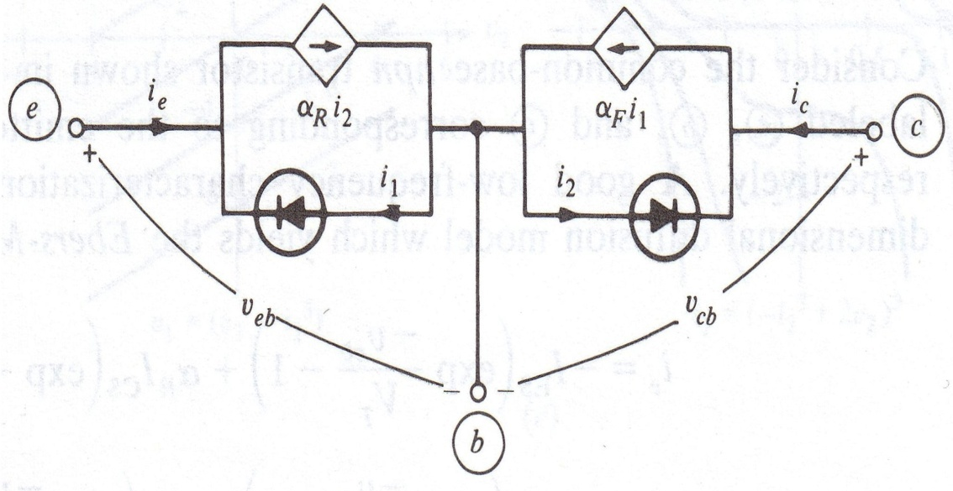
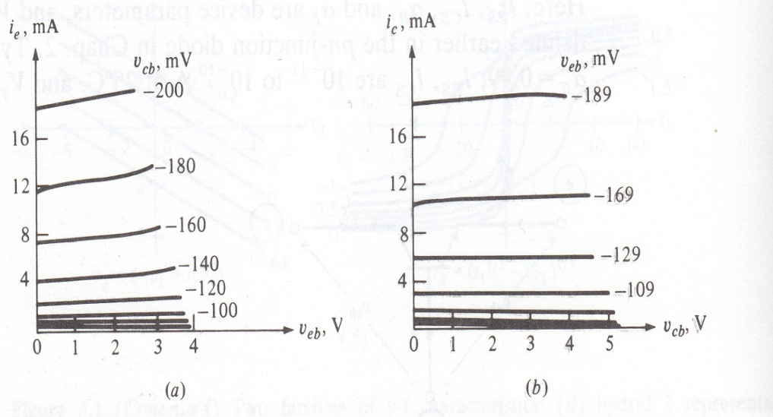
npn Bipolar Transistor
emittor
collector
Low Frequency Characterization
Ebers-Moll
Equations
Parameters:
base
Behaviour of the model
3-terminal element, voltage-controlled, reference?
L.O. Chua, C.A. Desoer, S.E. Kuh. “Linear and Nonlinear Circuits” Mc.Graw Hill, 1987, New York

Slide 2
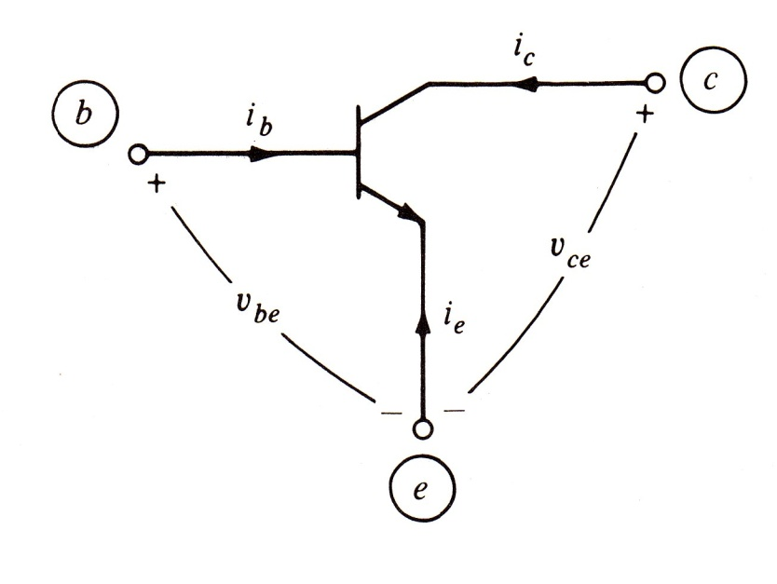
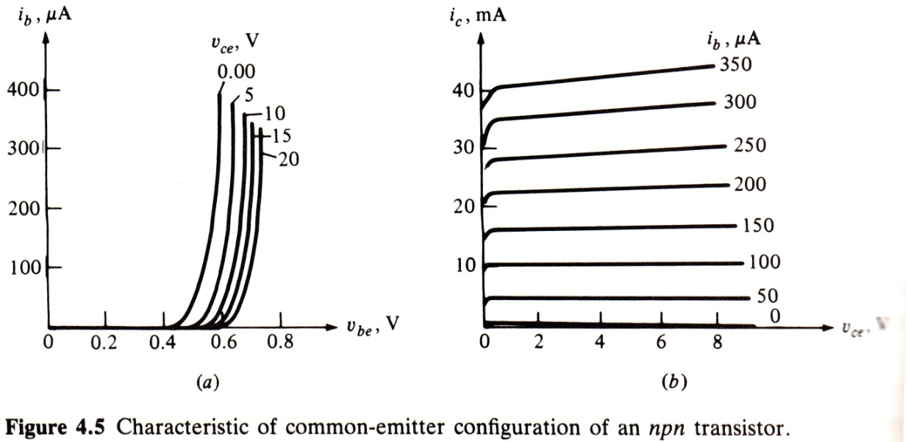
If the reference is chosen as the emittor...
Substitute in Ebers-Moll equations
Which representation is this?
L.O. Chua, C.A. Desoer, S.E. Kuh. “Linear and Nonlinear Circuits” Mc.Graw Hill, 1987, New York

Slide 3
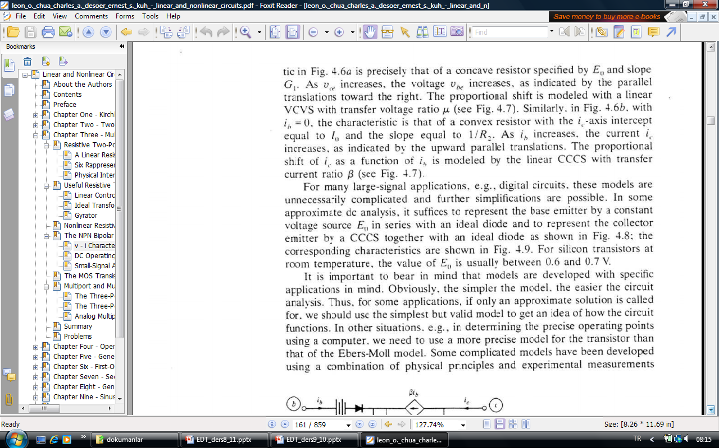
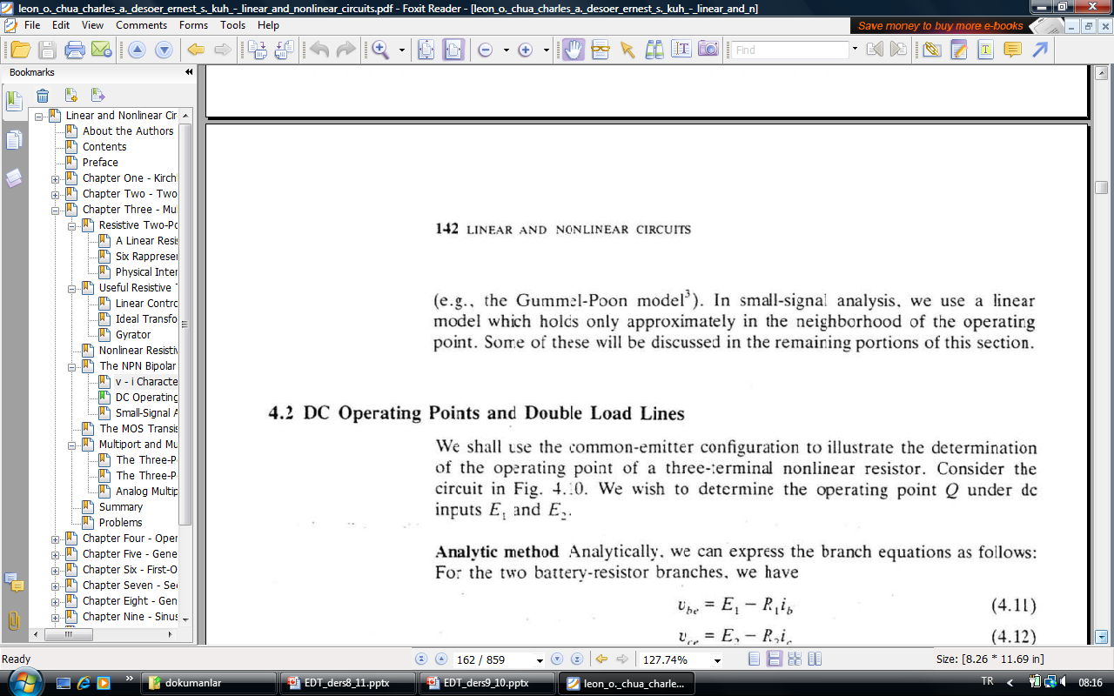
L.O. Chua, C.A. Desoer, S.E. Kuh. “Linear and Nonlinear Circuits” Mc.Graw Hill, 1987, New York

Slide 4
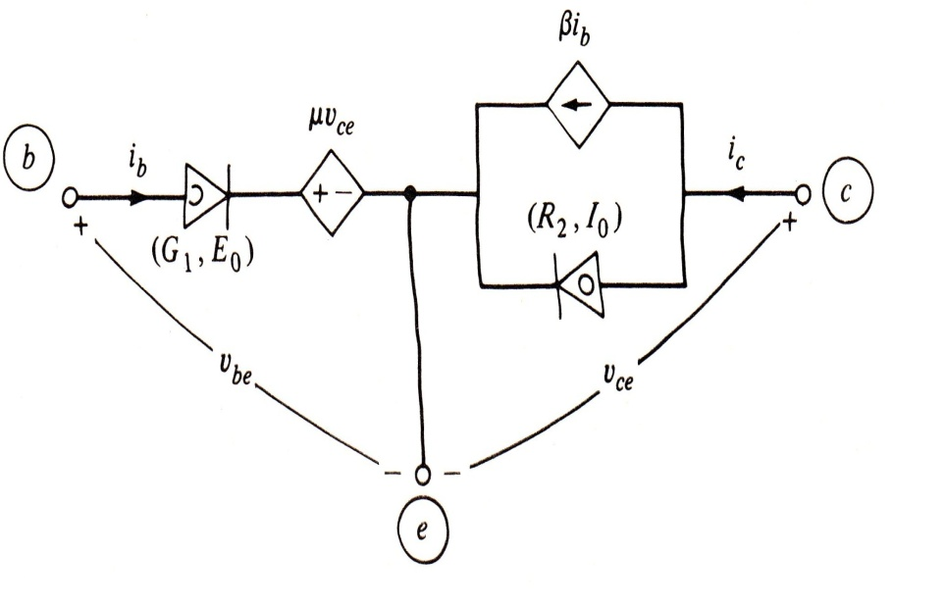
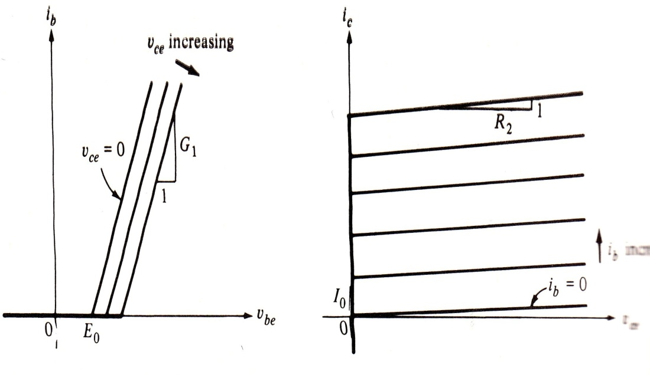
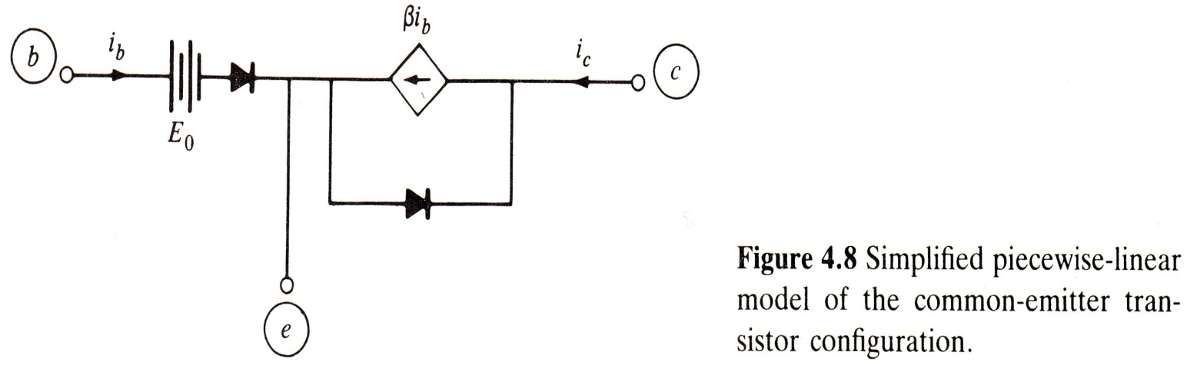
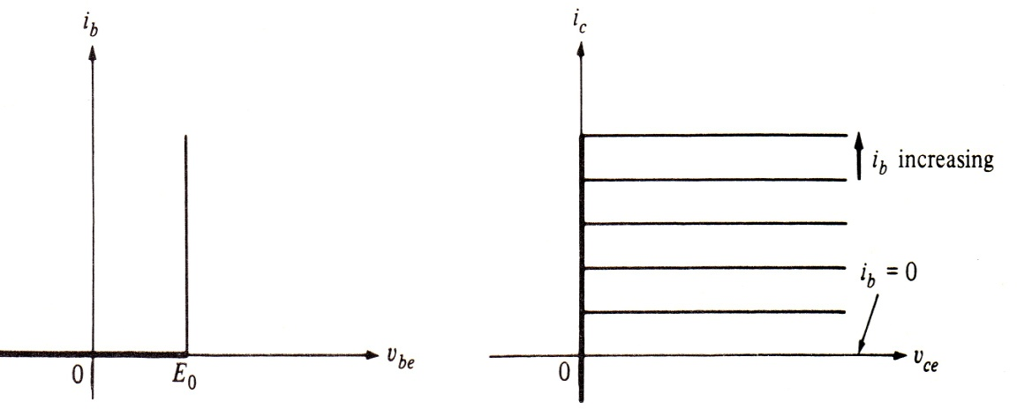
Piecewise-linear model
Ideal Model
L.O. Chua, C.A. Desoer, S.E. Kuh. “Linear and Nonlinear Circuits” Mc.Graw Hill, 1987, New York

Slide 5
DC Operating Points
i
N
1-port
2-terminal resistor
How many solutions:
one
more than one
no solution
+
I_{s}
v
_
i
+
I_{s}
unique solution
v
_
i
+
more than one solution
I_{s}
v
_

Slide 6
i
+
no solution
I_{s}
v
_
Input: value of the independent source
Output: voltage or current value of the element under consideration
In general, input consists of DC and AC parts. By linearity, one can consider DC and AC solutions seperately.
DC operating point is the value of the output when only DC input is considered.
How to find DC operating points?
i_{b}
d₁
i_{a}
KCL
+
KVL
+
EE
+
+
v_{b}
v_{a}
_
_
N_{b}
N_{a}
d_{1’}
Solutions of these equations give the DC operating points.

Slide 7
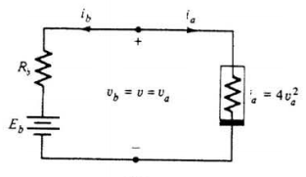
Find the DC operating points: ( $E_{b}=2, R_{b}=1/4$ )
L.O. Chua, C.A. Desoer, S.E. Kuh. “Linear and Nonlinear Circuits”, Mc.Graw Hill, 1987, New York

Slide 8
Small Signal Analysis
Assume that the input consists of a DC part and a small AC part:
Then the output is
If the AC part is small enough we can apply Taylor expansion and consider the linear term only: Linearization
i
+
N
v
_
I_{Q}
I_{Q}
V_{Q}
E_{DC}
Find the DC operating point.
E_{DC} +v_{m}
V_{Q}
E_{DC} -v_{m}
Find the linearization of the nonlinear element.

Slide 9
Linearization
Assumption:
Taylor expansion:
Small-signal conductivity

Slide 10
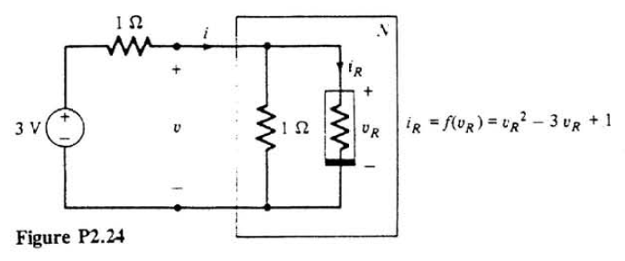
Find the DC operating points for v_{R} and using the linearization of the nonlinear resistor find an approximate value for v_{R}.
(3+
0.02sin(wt))
V

Slide 11
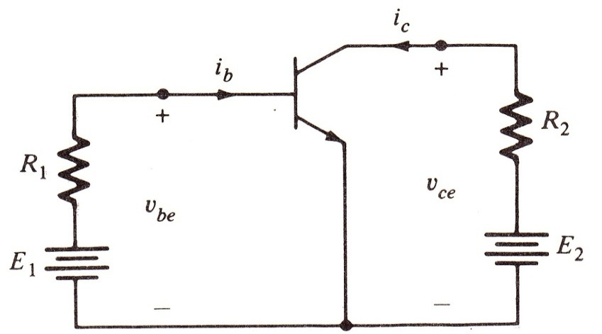
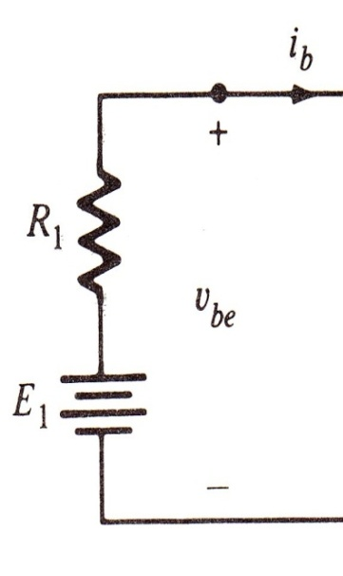
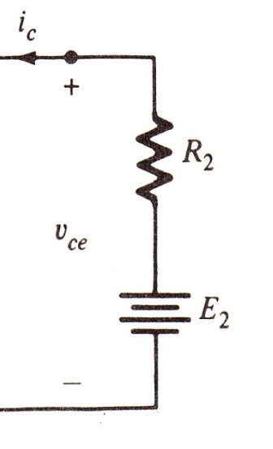
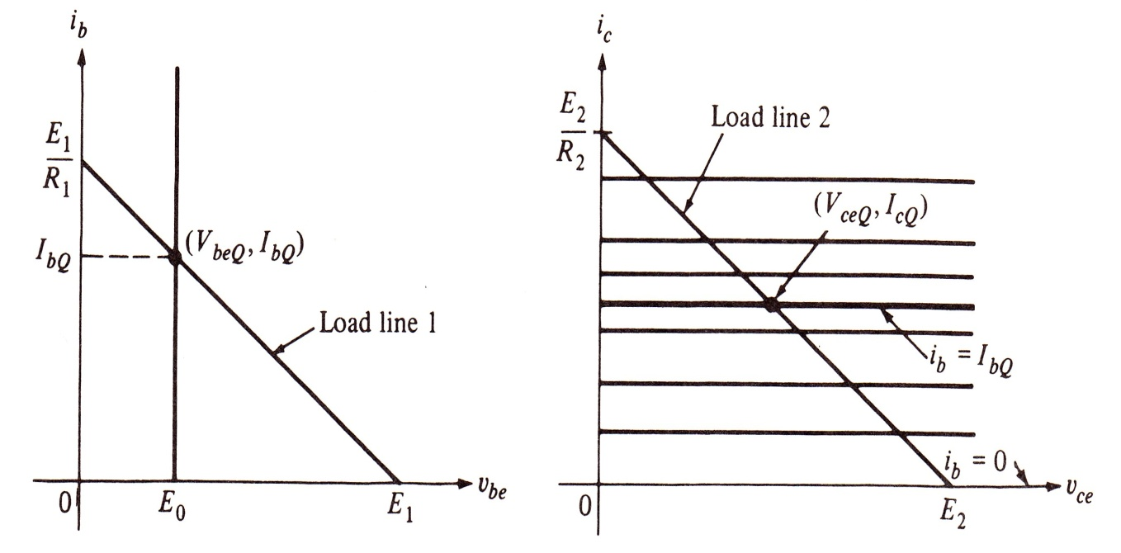



DC Operating Points for a Transistor
D₁
D₂
KVL+ KCL+EE -->
Assumption:
D₁ short circuit, D₂ open circuit
L.O. Chua, C.A. Desoer, S.E. Kuh. “Linear and Nonlinear Circuits” Mc.Graw Hill, 1987, New York

Slide 12
Small-Signal Analysis for 2-port nonlinear resistors
Find the operating points.
Find the linearization of the 2-port.
Current-conrolled
element equations
Operating point

Slide 13
Jakobian matrix

